Slide 1
Exploratory Data Analytics Project
Diwali Sales Analysis

Slide 2
Team Members
Khusbu Kumari
Suraj Kumar

Slide 3
Objective
The goal of this analysis is to improve customer experience by identifying potential customers across different states, occupation, gender and age groups
Implementation
Overview of data
Data Pre – Processing
Data Visualization
Draw the conclusion

Slide 4
Data Pre-processing
Null Handling
Renaming Columns
Removing irrelevant columns
Changing Datatypes of columns
Draw the charts

Slide 5
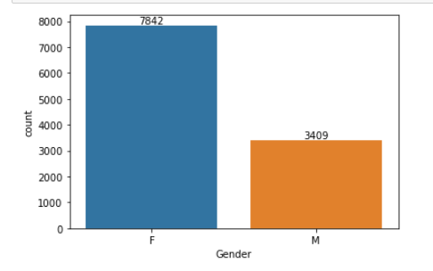
Count of Orders
From the above chart Females are ordering more as compare to male

Slide 6
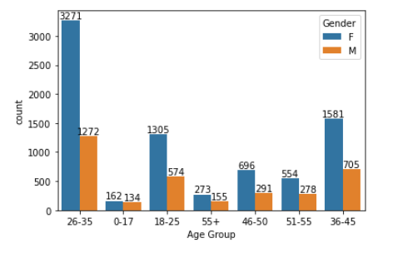
Age Group
From the above graph we can see that most of the buyers are of age group between 26 - 35 yrs female

Slide 7
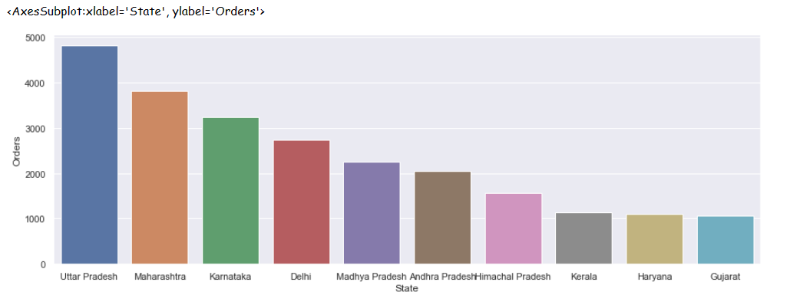
State
From the above graph we can see that most of the orders are from Uttar Pradesh, Maharashtra and Karnataka

Slide 8
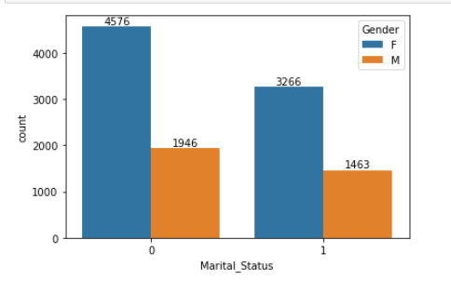
Marital Status
From the above graph we can see that most of the buyers are married (women)

Slide 9
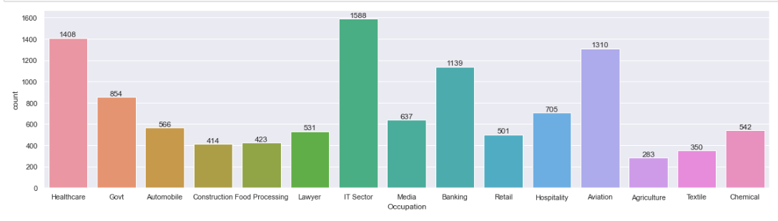
Occupation
From the above graphs we can see that most of the buyers are working in IT sector, Healthcare, Aviation

Slide 10
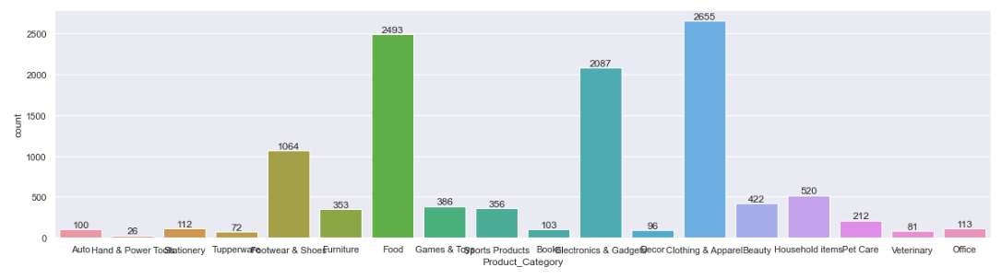
Product Category
From the above graph we can see that most of the sold products are from food, clothing and electronics

Slide 11
Project Learning
Perform Data Cleaning and Manipulation
Perform Exploratory Data Analysis (EDA) using Pandas, Matplotlib, Seaborn libraries
Draw the charts
Improve customer experience by identifying potential customers across different states, occupation, gender and age groups

Slide 12
Thank You

